Slide 1

NEW VALIDATION RESULTS

Slide 2
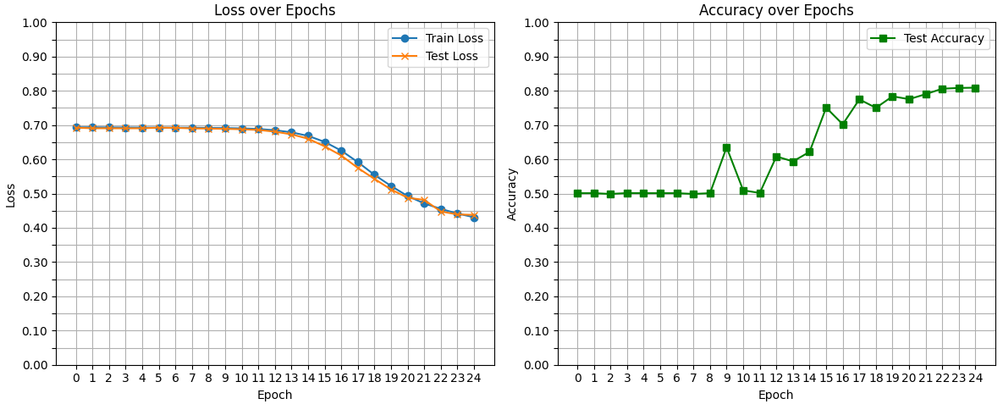
CORRECTED MD2 BACKBONE
(random_split validation)
training_loss test_accuracy test_loss
0 0.693393 0.501111 0.692216
1 0.693428 0.501111 0.690662
2 0.693011 0.498889 0.690550
3 0.692816 0.501389 0.690489
4 0.692597 0.501111 0.690549
5 0.692481 0.501111 0.692473
6 0.692346 0.501111 0.691863
7 0.692265 0.498889 0.690294
8 0.691674 0.501111 0.689731
9 0.691235 0.635000 0.688970
10 0.690322 0.509444 0.687732
11 0.688538 0.501667 0.685780
12 0.684944 0.608333 0.680703
13 0.678838 0.593889 0.672792
14 0.668415 0.621667 0.660144
15 0.650891 0.750833 0.637727
16 0.625320 0.702222 0.611006
17 0.591797 0.775000 0.574826
18 0.554623 0.750278 0.542843
19 0.522245 0.783889 0.512056
20 0.492714 0.775556 0.487669
21 0.471268 0.790278 0.481549
22 0.455223 0.806111 0.447691
23 0.441646 0.808333 0.439071
24 0.430785 0.809167 0.437674

Slide 3
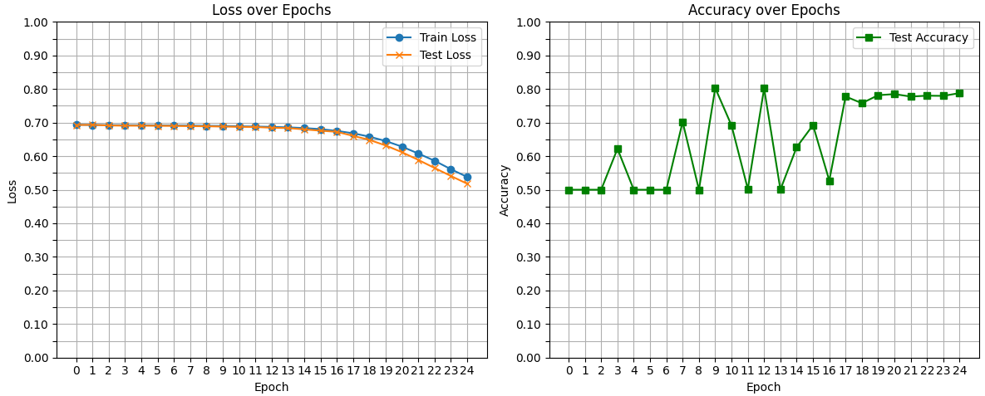
CORRECTED MD2 BACKBONE
(every 100 frames validation)
training_loss test_accuracy test_loss
0 0.693621 0.500000 0.692772
1 0.692834 0.500000 0.693259
2 0.692470 0.500000 0.691375
3 0.692236 0.622024 0.690756
4 0.692068 0.500000 0.690677
5 0.691630 0.500000 0.690413
6 0.691433 0.500000 0.690059
7 0.691090 0.702143 0.689387
8 0.690404 0.500000 0.688970
9 0.689936 0.802857 0.688066
10 0.688897 0.691429 0.687296
11 0.688185 0.502143 0.686757
12 0.687172 0.801905 0.684701
13 0.685807 0.500357 0.683637
14 0.683666 0.626905 0.679753
15 0.680500 0.692381 0.675833
16 0.675248 0.527262 0.672509
17 0.668194 0.777738 0.660431
18 0.658103 0.757738 0.648428
19 0.645075 0.781548 0.631813
20 0.628351 0.784881 0.611793
21 0.607866 0.777500 0.588857
22 0.586361 0.780119 0.564848
23 0.561140 0.779524 0.541020
24 0.538214 0.787857 0.517912

Slide 4
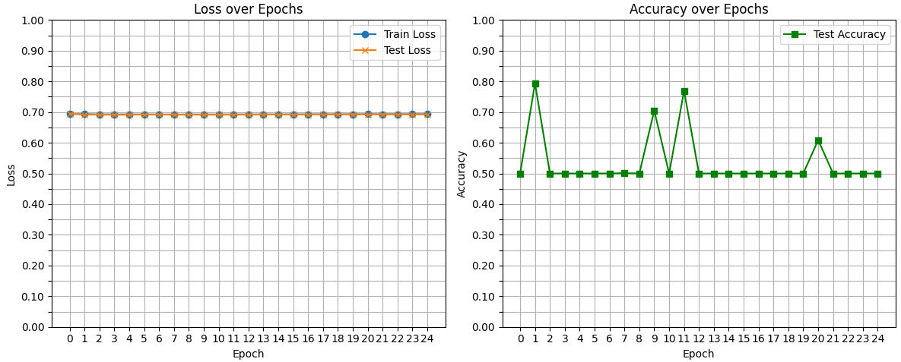
CORRECTED MD2 BACKBONE
(first and last 750 frames validation)
training_loss test_accuracy test_loss
0 0.693747 0.500000 0.695414
1 0.693226 0.793667 0.691367
2 0.692461 0.500000 0.691547
3 0.692462 0.500000 0.691170
4 0.692481 0.500000 0.691216
5 0.692258 0.500000 0.691880
6 0.692062 0.500000 0.691918
7 0.691969 0.501000 0.691225
8 0.692138 0.500000 0.691283
9 0.692234 0.704667 0.691254
10 0.692211 0.500000 0.691408
11 0.692365 0.769222 0.691378
12 0.692449 0.500000 0.691506
13 0.692238 0.500000 0.691998
14 0.692510 0.500000 0.691679
15 0.692655 0.500000 0.691756
16 0.692475 0.500000 0.692069
17 0.692689 0.500000 0.692128
18 0.692643 0.500000 0.692352
19 0.692853 0.500000 0.692270
20 0.692972 0.608667 0.692203
21 0.692900 0.500000 0.692555
22 0.692884 0.500000 0.692409
23 0.693101 0.500000 0.692422
24 0.693115 0.500000 0.692444

Slide 5
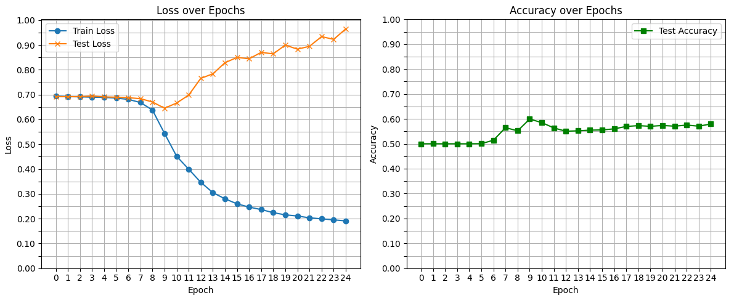
CORRECTED MD2 BACKBONE
(manual split validation soft)
training_loss test_accuracy test_loss
0 0.693401 0.500000 0.691681
1 0.692069 0.500167 0.691499
2 0.690967 0.500000 0.691733
3 0.689527 0.500000 0.693925
4 0.688621 0.500000 0.690668
5 0.686054 0.500500 0.689428
6 0.680538 0.514333 0.687435
7 0.668251 0.564833 0.683676
8 0.637793 0.552000 0.670241
9 0.543483 0.599167 0.645077
10 0.451685 0.585167 0.665909
11 0.399268 0.563667 0.697955
12 0.346623 0.550333 0.765371
13 0.304871 0.552167 0.783674
14 0.280045 0.554833 0.828327
15 0.259727 0.555667 0.849865
16 0.246632 0.560000 0.844308
17 0.236617 0.569667 0.870037
18 0.224150 0.572833 0.864208
19 0.215296 0.570167 0.899617
20 0.210690 0.573500 0.883079
21 0.203354 0.570667 0.894595
22 0.199391 0.575167 0.933691
23 0.195165 0.570667 0.922611
24 0.190911 0.579667 0.964773

Slide 6
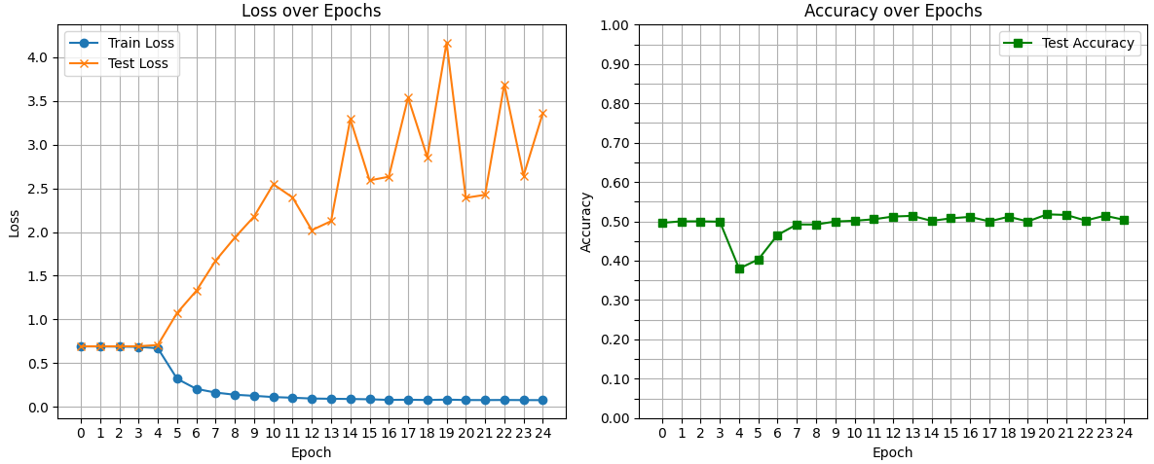
CORRECTED MD2 BACKBONE
(manual split validation strong)
training_loss test_accuracy test_loss
0 0.692915 0.496222 0.692652
1 0.691719 0.500000 0.692855
2 0.689883 0.500000 0.692919
3 0.686818 0.499111 0.693239
4 0.670975 0.379889 0.708120
5 0.321572 0.403222 1.074346
6 0.206128 0.465444 1.327716
7 0.164230 0.492000 1.671803
8 0.139239 0.491889 1.936665
9 0.126587 0.499667 2.177294
10 0.112647 0.501444 2.546751
11 0.104925 0.505222 2.395533
12 0.095878 0.512222 2.021564
13 0.092833 0.513889 2.124706
14 0.090659 0.501111 3.291546
15 0.086985 0.507667 2.590931
16 0.080219 0.511333 2.632648
17 0.082094 0.499889 3.537472
18 0.079007 0.511667 2.856450
19 0.083369 0.499778 4.167562
20 0.078736 0.517778 2.391324
21 0.078332 0.516222 2.425917
22 0.079177 0.502000 3.690027
23 0.078070 0.514333 2.644563
24 0.077460 0.503889 3.359573

Slide 8
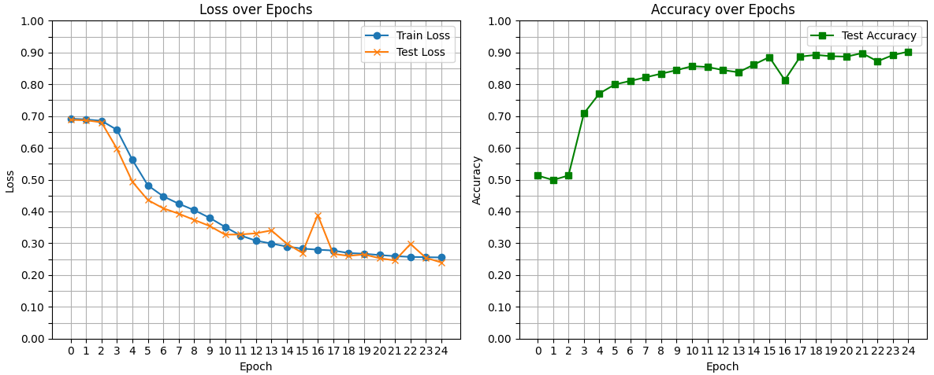
MD2 SPECIFIC RESIDUES
(random_split validation)
training_loss test_accuracy test_loss
0 0.691711 0.513056 0.688325
1 0.689345 0.498889 0.686663
2 0.685199 0.513056 0.680340
3 0.656842 0.708333 0.597438
4 0.562177 0.771111 0.493407
5 0.482199 0.799444 0.436046
6 0.447536 0.810556 0.409797
7 0.424337 0.821944 0.392973
8 0.404158 0.833333 0.373451
9 0.379938 0.844444 0.354318
10 0.351423 0.856944 0.327102
11 0.324374 0.854444 0.327722
12 0.308088 0.844722 0.331215
13 0.299073 0.837778 0.340449
14 0.289523 0.861944 0.298417
15 0.283069 0.885556 0.269697
16 0.279797 0.813333 0.388633
17 0.277135 0.886944 0.266490
18 0.269155 0.892500 0.260377
19 0.266970 0.888333 0.264854
20 0.262815 0.886944 0.252850
21 0.259519 0.898056 0.245892
22 0.257098 0.872222 0.297606
23 0.256133 0.891944 0.254190
24 0.255303 0.902778 0.239483

Slide 9
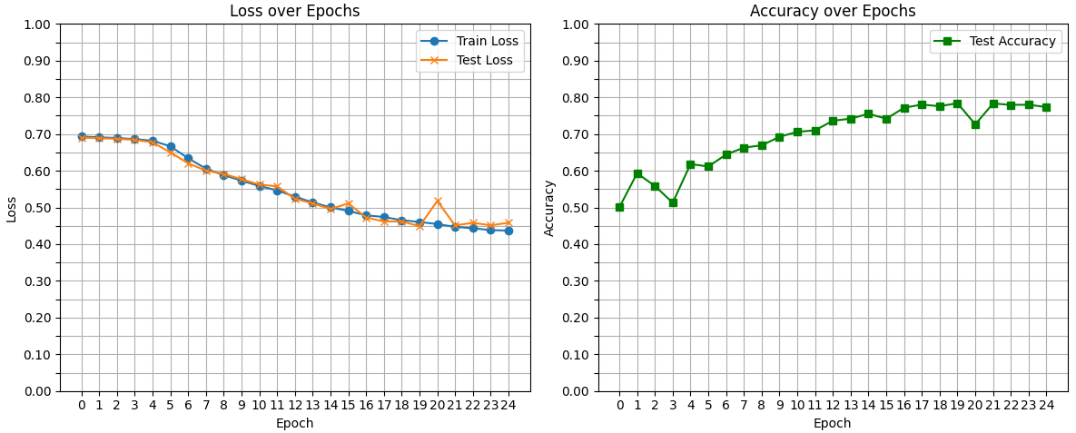
MD2 SPECIFIC RESIDUES
(every 100 frames validation)
training_loss test_accuracy test_loss
0 0.692986 0.500119 0.690442
1 0.691050 0.592976 0.688549
2 0.689062 0.558571 0.686932
3 0.686227 0.512738 0.684206
4 0.681858 0.618214 0.677344
5 0.666638 0.611548 0.650037
6 0.634129 0.644167 0.620289
7 0.605777 0.662976 0.600382
8 0.587994 0.669167 0.591454
9 0.572875 0.692500 0.577072
10 0.558463 0.705952 0.562340
11 0.546503 0.710119 0.557485
12 0.529414 0.736190 0.523838
13 0.513794 0.741905 0.510980
14 0.500189 0.755119 0.495670
15 0.490623 0.741786 0.511030
16 0.478579 0.771548 0.472766
17 0.473956 0.780238 0.461972
18 0.465399 0.775714 0.461771
19 0.460453 0.783929 0.449072
20 0.454713 0.726310 0.517504
21 0.447055 0.783333 0.451074
22 0.443345 0.779405 0.458138
23 0.438285 0.779881 0.451279
24 0.436884 0.773333 0.458361

Slide 10
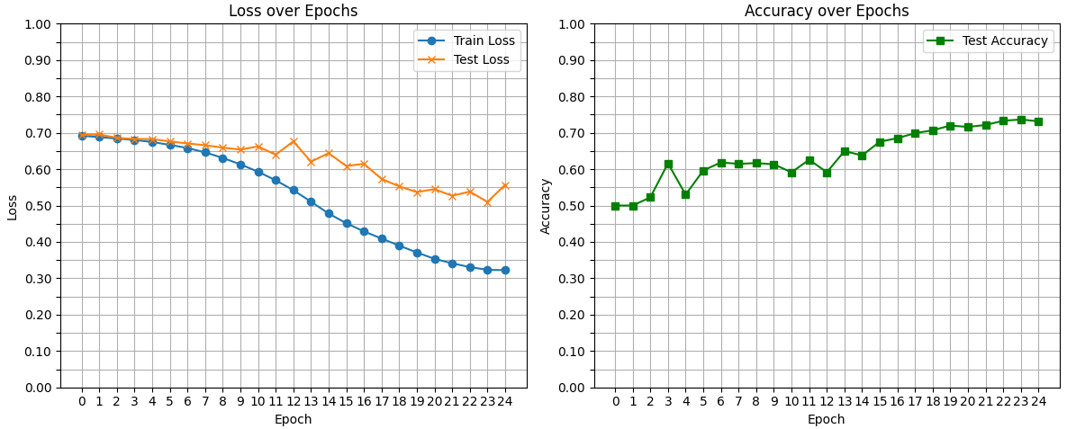
MD2 SPECIFIC RESIDUES
(first and last 750 frames validation)
training_loss test_accuracy test_loss
0 0.691840 0.500000 0.694015
1 0.688149 0.500000 0.695436
2 0.684199 0.522444 0.686131
3 0.680268 0.615889 0.682851
4 0.674697 0.530000 0.682749
5 0.666762 0.596444 0.676256
6 0.658208 0.618556 0.670659
7 0.646138 0.614556 0.665797
8 0.630980 0.616778 0.659183
9 0.613230 0.613222 0.653868
10 0.593083 0.591333 0.662447
11 0.569397 0.626111 0.639832
12 0.542245 0.591444 0.676278
13 0.510671 0.649778 0.620790
14 0.478031 0.637667 0.643866
15 0.451312 0.675556 0.608621
16 0.428904 0.685222 0.614772
17 0.409217 0.699000 0.573231
18 0.389833 0.706889 0.552736
19 0.370909 0.720000 0.537082
20 0.353438 0.716111 0.544919
21 0.341100 0.721556 0.526889
22 0.330786 0.733111 0.538327
23 0.323222 0.736556 0.509860
24 0.322326 0.731444 0.556872

Slide 11
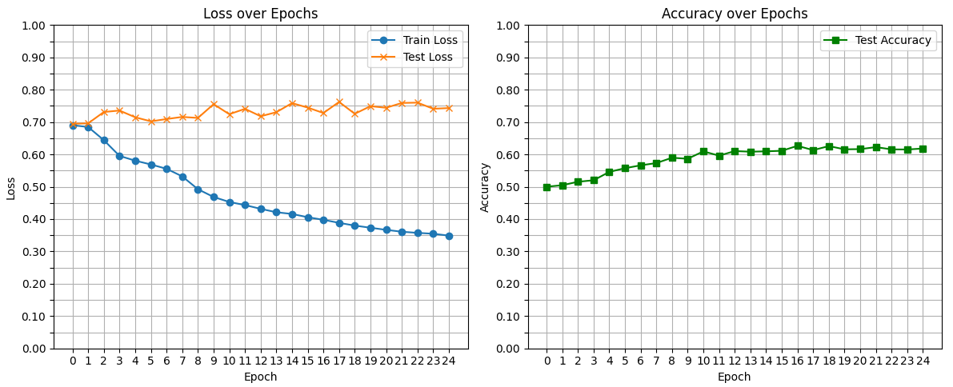
MD2 SPECIFIC RESIDUES
(manual validation soft)
training_loss test_accuracy test_loss
0 0.690351 0.500000 0.694722
1 0.684725 0.504667 0.695957
2 0.644083 0.515333 0.731087
3 0.595370 0.520000 0.735670
4 0.580621 0.545833 0.714835
5 0.568868 0.557333 0.702134
6 0.555456 0.566167 0.709330
7 0.531986 0.573167 0.715888
8 0.492284 0.589667 0.712776
9 0.468270 0.586500 0.755331
10 0.452887 0.609333 0.724263
11 0.443262 0.596000 0.740898
12 0.431631 0.610333 0.717908
13 0.421068 0.608333 0.730533
14 0.415791 0.609500 0.758576
15 0.405748 0.611167 0.744709
16 0.397650 0.626500 0.727996
17 0.388276 0.613167 0.762212
18 0.379796 0.625667 0.725550
19 0.373156 0.615667 0.749123
20 0.366623 0.616333 0.744219
21 0.360835 0.622500 0.759085
22 0.357320 0.615500 0.760084
23 0.354618 0.615167 0.741142
24 0.348786 0.618167 0.743269

Slide 12
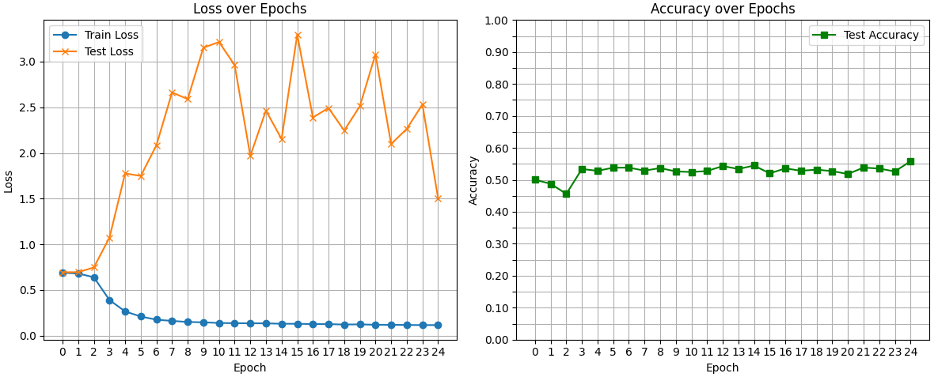
MD2 SPECIFIC RESIDUES
(manual validation strong)
training_loss test_accuracy test_loss
0 0.688660 0.500222 0.693848
1 0.680217 0.487667 0.695321
2 0.639883 0.456000 0.746452
3 0.390093 0.533889 1.073803
4 0.265510 0.528111 1.775503
5 0.209987 0.538111 1.748292
6 0.175000 0.538111 2.084292
7 0.162029 0.528778 2.662332
8 0.150045 0.536778 2.588988
9 0.146500 0.526222 3.151663
10 0.139089 0.524444 3.213749
11 0.137154 0.527556 2.961666
12 0.135699 0.543111 1.967719
13 0.135011 0.533889 2.464253
14 0.130394 0.544667 2.151783
15 0.130254 0.520222 3.295641
16 0.126932 0.535778 2.388551
17 0.126335 0.528444 2.491952
18 0.122265 0.531778 2.245390
19 0.123731 0.527222 2.510742
20 0.119702 0.518333 3.078828
21 0.118875 0.538333 2.097657
22 0.117476 0.535222 2.263660
23 0.115808 0.526222 2.530567
24 0.116135 0.558111 1.506331

Slide 13
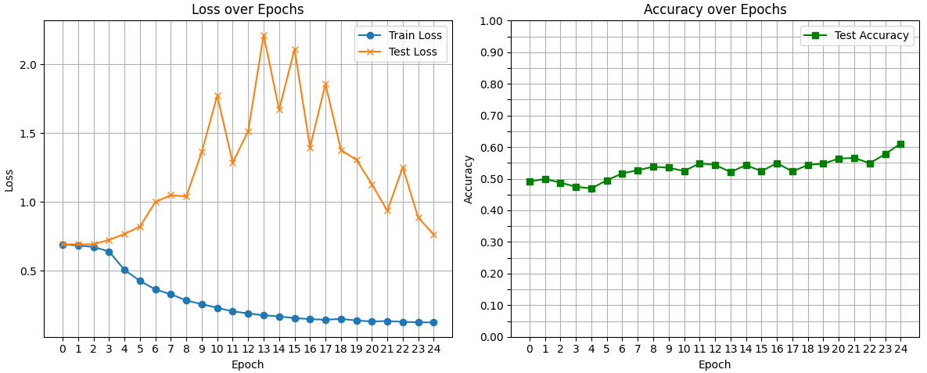
MD2 SPECIFIC RESIDUES
(manual validation strong dropout)
training_loss test_accuracy test_loss
0 0.691932 0.490889 0.692546
1 0.684373 0.499222 0.693122
2 0.673615 0.487556 0.693278
3 0.641056 0.474667 0.725166
4 0.508122 0.469222 0.767109
5 0.427773 0.495111 0.822161
6 0.365109 0.516667 0.999887
7 0.330728 0.527000 1.050101
8 0.285848 0.537889 1.040267
9 0.258835 0.534778 1.362294
10 0.232604 0.524333 1.771557
11 0.206346 0.548444 1.286336
12 0.191953 0.543778 1.513189
13 0.177879 0.521222 2.211533
14 0.170241 0.542778 1.669922
15 0.157623 0.524000 2.108315
16 0.150448 0.549222 1.395792
17 0.145430 0.522889 1.856507
18 0.152425 0.543556 1.377020
19 0.140138 0.547667 1.306350
20 0.133229 0.563556 1.128928
21 0.136440 0.565778 0.936476
22 0.130515 0.548889 1.252234
23 0.127519 0.577556 0.885499
24 0.126144 0.611222 0.765634

Slide 14
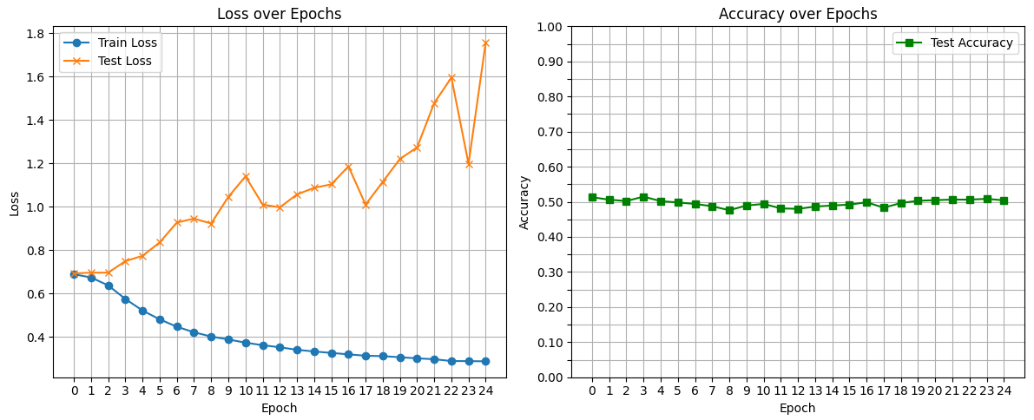
MD2 SPECIFIC RESIDUES
(manual validation strong dropout more data)
training_loss test_accuracy test_loss
0 0.689366 0.513056 0.693120
1 0.674374 0.506000 0.696554
2 0.637810 0.502056 0.696664
3 0.575277 0.514722 0.749846
4 0.521948 0.501833 0.774167
5 0.481359 0.498111 0.835870
6 0.447436 0.493889 0.927717
7 0.421752 0.487278 0.945632
8 0.402102 0.476056 0.923279
9 0.388684 0.489333 1.045798
10 0.373953 0.493944 1.140297
11 0.362145 0.481167 1.010775
12 0.352718 0.479889 0.997409
13 0.341018 0.486333 1.057189
14 0.333415 0.489333 1.087690
15 0.326633 0.491889 1.103743
16 0.320025 0.498556 1.186518
17 0.313697 0.483167 1.010200
18 0.311915 0.496444 1.115186
19 0.306715 0.502889 1.221027
20 0.301740 0.504722 1.273789
21 0.297589 0.506222 1.478773
22 0.289289 0.506111 1.595681
23 0.288777 0.508444 1.198193
24 0.288070 0.504056 1.758507

Slide 16
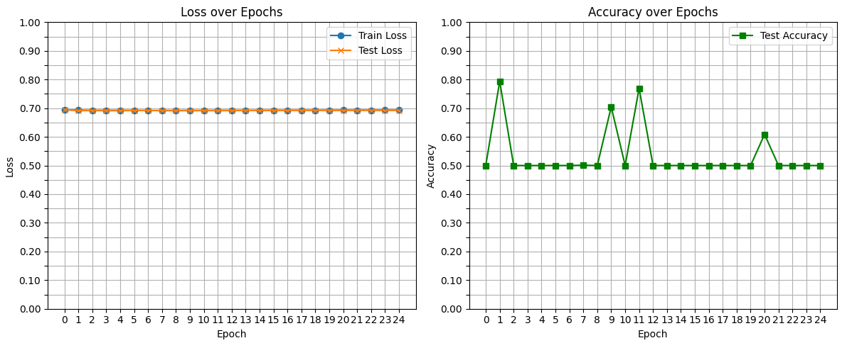
MD2 POLAR REGION
(random_split validation)
training_loss test_accuracy test_loss
0 0.693747 0.500000 0.695414
1 0.693226 0.793667 0.691367
2 0.692461 0.500000 0.691547
3 0.692462 0.500000 0.691170
4 0.692481 0.500000 0.691216
5 0.692258 0.500000 0.691880
6 0.692062 0.500000 0.691918
7 0.691969 0.501000 0.691225
8 0.692138 0.500000 0.691283
9 0.692234 0.704667 0.691254
10 0.692211 0.500000 0.691408
11 0.692365 0.769222 0.691378
12 0.692449 0.500000 0.691506
13 0.692238 0.500000 0.691998
14 0.692510 0.500000 0.691679
15 0.692655 0.500000 0.691756
16 0.692475 0.500000 0.692069
17 0.692689 0.500000 0.692128
18 0.692643 0.500000 0.692352
19 0.692853 0.500000 0.692270
20 0.692972 0.608667 0.692203
21 0.692900 0.500000 0.692555
22 0.692884 0.500000 0.692409
23 0.693101 0.500000 0.692422
24 0.693115 0.500000 0.692444

Slide 17
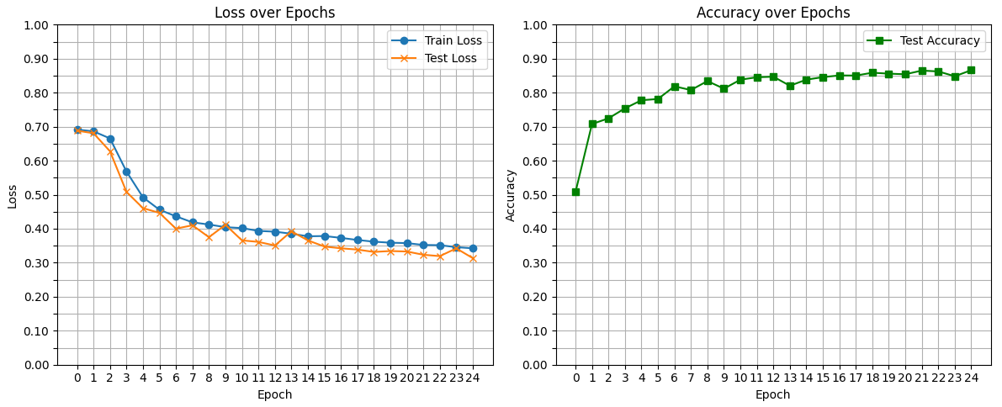
MD2 POLAR REGION
(every 100 frames validation)
training_loss test_accuracy test_loss
0 0.691615 0.507857 0.688332
1 0.686263 0.707857 0.680696
2 0.665495 0.724524 0.627720
3 0.568060 0.753929 0.508254
4 0.492190 0.777857 0.460493
5 0.455693 0.781429 0.446364
6 0.436391 0.818690 0.400131
7 0.418689 0.807738 0.410086
8 0.412307 0.834167 0.374973
9 0.404470 0.811786 0.411545
10 0.401844 0.838214 0.365691
11 0.393549 0.845357 0.361162
12 0.391239 0.847024 0.350571
13 0.385226 0.820357 0.392348
14 0.377691 0.838333 0.365610
15 0.378455 0.845714 0.347599
16 0.373037 0.850714 0.342380
17 0.366867 0.850357 0.338621
18 0.361874 0.858690 0.331633
19 0.358830 0.855952 0.334357
20 0.357646 0.854167 0.332927
21 0.352180 0.865000 0.323398
22 0.351577 0.862500 0.319346
23 0.345689 0.848333 0.342183
24 0.342404 0.866190 0.313357

Slide 18
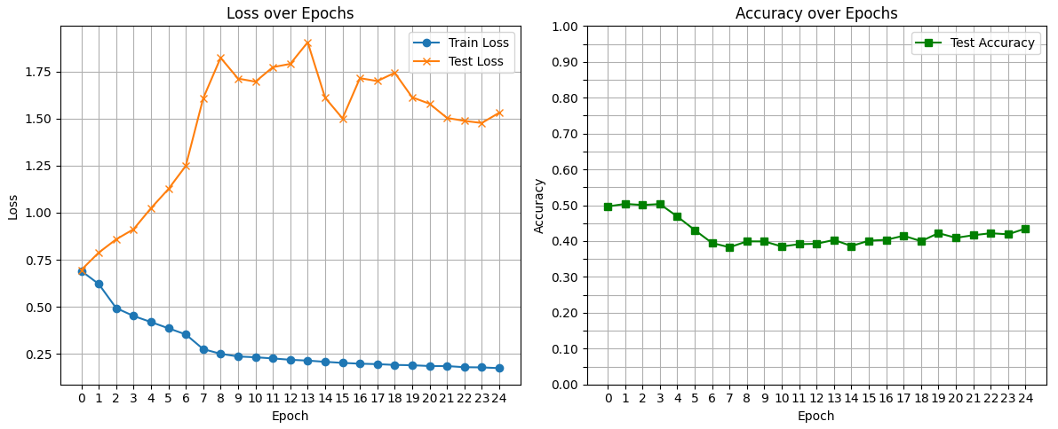
MD2 POLAR REGION
(manual validation soft)
training_loss test_accuracy test_loss
0 0.690743 0.496500 0.696189
1 0.621275 0.503667 0.788093
2 0.493588 0.500667 0.858621
3 0.451615 0.503167 0.912299
4 0.419221 0.468500 1.024013
5 0.386258 0.430667 1.125505
6 0.353434 0.394500 1.248944
7 0.275453 0.382667 1.607720
8 0.250491 0.399167 1.823128
9 0.236386 0.399000 1.712519
10 0.232222 0.384833 1.696019
11 0.226004 0.391333 1.773180
12 0.218822 0.392500 1.790512
13 0.214440 0.403167 1.905250
14 0.208037 0.386167 1.611190
15 0.202337 0.401000 1.501130
16 0.198063 0.403500 1.714730
17 0.195713 0.414833 1.699359
18 0.191492 0.399667 1.743315
19 0.189823 0.422167 1.613196
20 0.185675 0.409000 1.578664
21 0.185393 0.416333 1.503472
22 0.179419 0.421833 1.487736
23 0.178355 0.418833 1.476563
24 0.174375 0.435000 1.531199

Slide 19
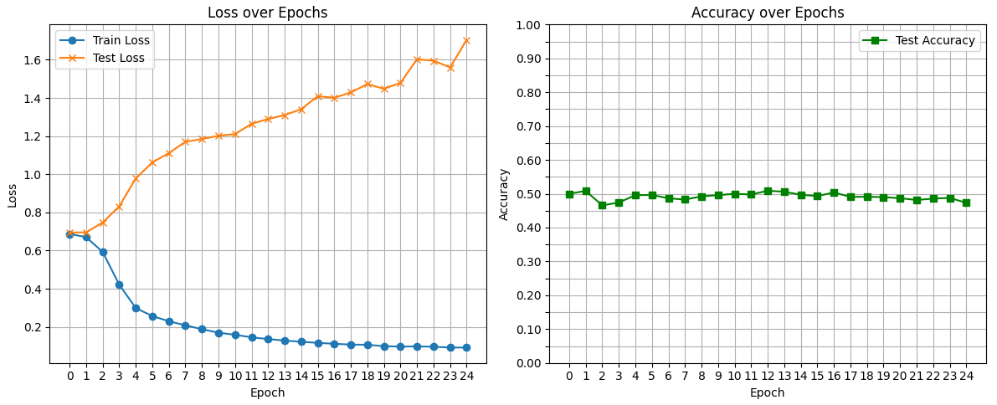
MD2 POLAR REGION
(manual validation strong)
training_loss test_accuracy test_loss
0 0.687487 0.500000 0.694784
1 0.670520 0.508333 0.695483
2 0.592788 0.465667 0.747285
3 0.421789 0.474000 0.831536
4 0.298930 0.495778 0.978440
5 0.257039 0.496444 1.061948
6 0.229918 0.486556 1.110728
7 0.208393 0.482778 1.170014
8 0.187977 0.492333 1.184573
9 0.169755 0.495778 1.201654
10 0.158655 0.499889 1.210509
11 0.145463 0.497667 1.264361
12 0.136199 0.509000 1.289778
13 0.128512 0.505778 1.310103
14 0.122155 0.497111 1.340886
15 0.116451 0.493000 1.409111
16 0.111633 0.503778 1.400493
17 0.107407 0.490778 1.429166
18 0.106403 0.491111 1.472493
19 0.099117 0.490000 1.447760
20 0.096861 0.486778 1.479109
21 0.098141 0.481556 1.602673
22 0.096054 0.485667 1.594882
23 0.091871 0.487667 1.559973
24 0.091969 0.473222 1.703920

Slide 21
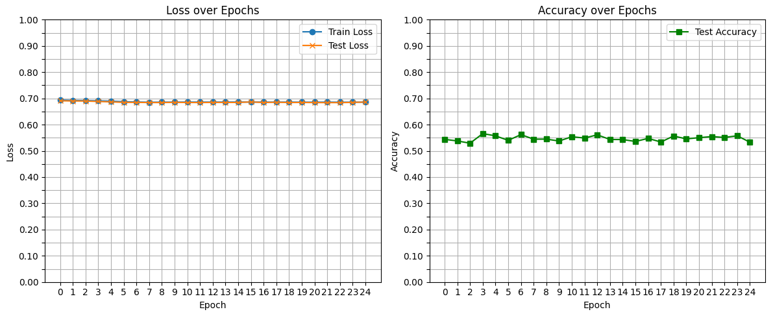
CONTROL NEGATIVO
(random_split validation)
training_loss test_accuracy test_loss
0 0.693756 0.543889 0.690766
1 0.692505 0.537778 0.690013
2 0.691709 0.529167 0.689723
3 0.690668 0.565833 0.688113
4 0.689437 0.557222 0.686669
5 0.687499 0.540000 0.684714
6 0.686242 0.561944 0.684714
7 0.685438 0.544444 0.684064
8 0.685649 0.544722 0.684007
9 0.685851 0.537500 0.684847
10 0.685979 0.553889 0.684228
11 0.685938 0.548889 0.684039
12 0.685944 0.561111 0.684525
13 0.686046 0.543333 0.684443
14 0.686160 0.543056 0.684402
15 0.685930 0.535833 0.686547
16 0.685980 0.547500 0.684068
17 0.685685 0.533611 0.685392
18 0.685970 0.556667 0.684082
19 0.685551 0.545556 0.684482
20 0.685703 0.550278 0.683919
21 0.685831 0.554444 0.683791
22 0.685537 0.551111 0.683773
23 0.685564 0.557500 0.684650
24 0.685603 0.532778 0.685996

Slide 22
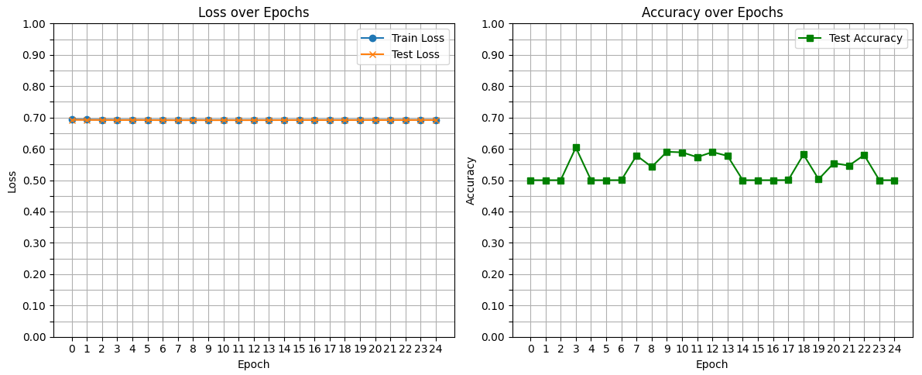
CONTROL NEGATIVO
(every 100 frames validation)
training_loss test_accuracy test_loss
0 0.693891 0.500000 0.692520
1 0.692985 0.500000 0.692218
2 0.692946 0.500000 0.692078
3 0.692706 0.604167 0.691511
4 0.692528 0.500000 0.692197
5 0.692445 0.500000 0.691781
6 0.692430 0.500119 0.691476
7 0.692027 0.578690 0.691352
8 0.692424 0.542262 0.691382
9 0.692306 0.590595 0.691378
10 0.692269 0.588810 0.691415
11 0.692186 0.573452 0.691457
12 0.692341 0.589762 0.691492
13 0.692348 0.577381 0.691532
14 0.692165 0.500000 0.691740
15 0.692396 0.500000 0.691746
16 0.692411 0.500000 0.691720
17 0.692434 0.500357 0.691711
18 0.692413 0.581786 0.691698
19 0.692448 0.502976 0.691775
20 0.692527 0.554286 0.691749
21 0.692539 0.546548 0.691763
22 0.692553 0.580238 0.691754
23 0.692342 0.500000 0.692012
24 0.692522 0.500000 0.691878

Slide 23
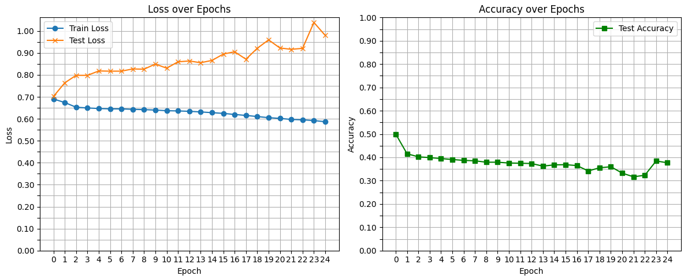
CONTROL NEGATIVO
(manual validation soft)
training_loss test_accuracy test_loss
0 0.690311 0.500000 0.701815
1 0.674084 0.415500 0.763933
2 0.652772 0.402167 0.797960
3 0.649429 0.399000 0.797805
4 0.646803 0.394833 0.817930
5 0.645347 0.390667 0.816854
6 0.645080 0.387000 0.817001
7 0.643219 0.385167 0.826996
8 0.641711 0.379167 0.825994
9 0.639904 0.379167 0.849327
10 0.636883 0.375667 0.830493
11 0.635884 0.374833 0.859613
12 0.634138 0.373500 0.863321
13 0.631355 0.362333 0.855416
14 0.628000 0.367833 0.865845
15 0.624707 0.368500 0.894686
16 0.619782 0.364833 0.905248
17 0.615406 0.341667 0.871323
18 0.610345 0.355167 0.921225
19 0.605247 0.359833 0.959320
20 0.601888 0.332333 0.922462
21 0.597127 0.316500 0.916429
22 0.595352 0.323333 0.920809
23 0.591971 0.384667 1.038734
24 0.586821 0.376500 0.979737

Slide 24
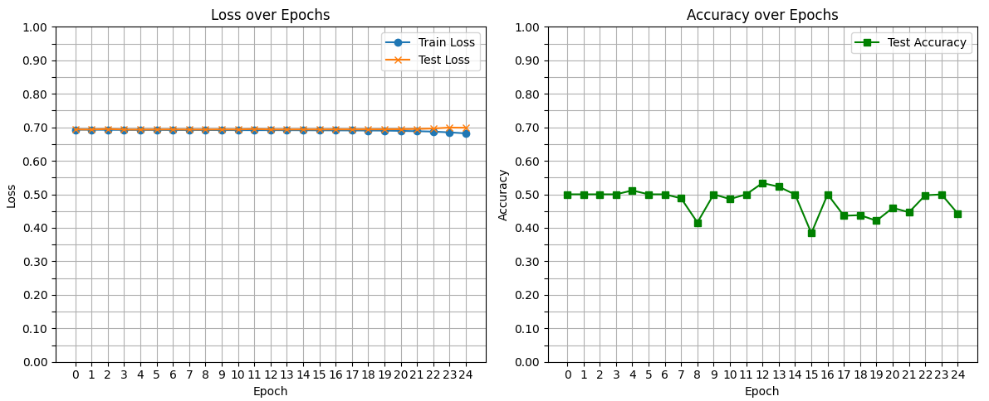
CONTROL NEGATIVO
(manual validation strong)
training_loss test_accuracy test_loss
0 0.692872 0.500000 0.693657
1 0.692887 0.500000 0.693306
2 0.692540 0.500000 0.695030
3 0.692295 0.500000 0.693277
4 0.692209 0.511556 0.693184
5 0.692125 0.500000 0.693377
6 0.691987 0.500000 0.693631
7 0.692012 0.488000 0.693266
8 0.691888 0.415889 0.693297
9 0.691712 0.500000 0.693601
10 0.691641 0.485778 0.693462
11 0.691414 0.500000 0.694936
12 0.691566 0.533667 0.693521
13 0.691476 0.522667 0.693510
14 0.691294 0.499444 0.693647
15 0.691088 0.383889 0.693597
16 0.690920 0.499889 0.693815
17 0.690649 0.436000 0.693713
18 0.690457 0.437778 0.693850
19 0.690165 0.421111 0.694021
20 0.689309 0.459556 0.694343
21 0.688424 0.446444 0.695005
22 0.687221 0.497222 0.696480
23 0.684868 0.499556 0.699218
24 0.681943 0.442222 0.698689

Slide 26
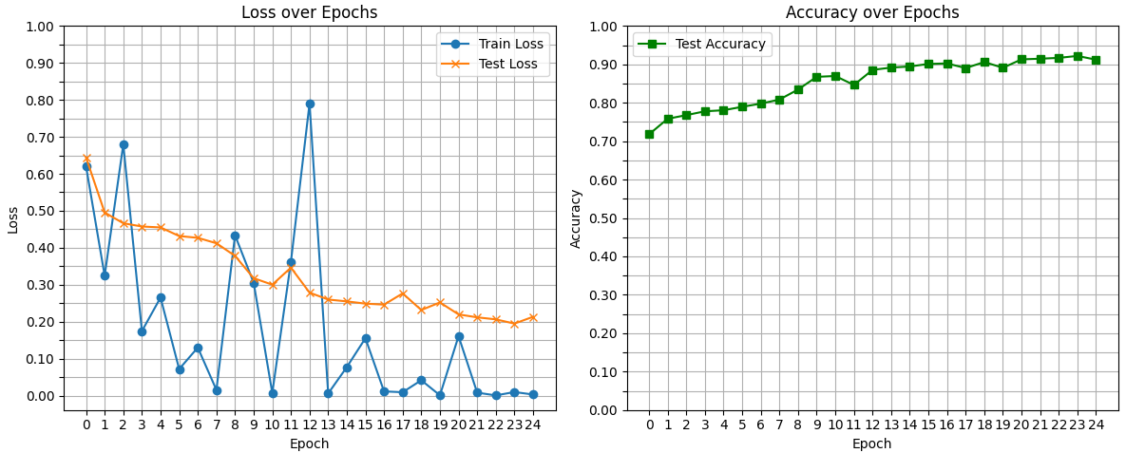
GRAPH ATTENTION NETWORK
(random_split validation)
training_loss test_accuracy test_loss
0 0.620241 0.717778 0.644186
1 0.324134 0.758333 0.495356
2 0.679754 0.767778 0.466345
3 0.174520 0.777778 0.457469
4 0.265177 0.780556 0.454989
5 0.071745 0.789444 0.431654
6 0.129964 0.797778 0.426802
7 0.015299 0.808333 0.412195
8 0.433717 0.834444 0.377971
9 0.305307 0.867500 0.317659
10 0.007134 0.869722 0.300118
11 0.361874 0.846389 0.346238
12 0.790515 0.885556 0.278605
13 0.005683 0.891667 0.259904
14 0.077053 0.894444 0.254886
15 0.155213 0.901111 0.248855
16 0.011433 0.902500 0.246122
17 0.009125 0.890278 0.276509
18 0.041637 0.906111 0.231529
19 0.000734 0.891111 0.252084
20 0.160774 0.913056 0.219671
21 0.008027 0.914722 0.211704
22 0.000547 0.916944 0.206298
23 0.009631 0.921944 0.194763
24 0.002966 0.912222 0.213208

Slide 27
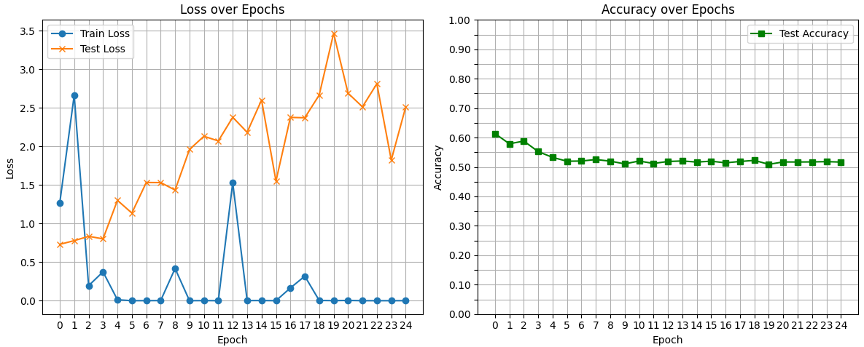
GRAPH ATTENTION NETWORK
(manual validation)
training_loss test_accuracy test_loss
0 1.268468 0.613556 0.730295
1 2.663158 0.578778 0.778108
2 0.194851 0.588111 0.834206
3 0.374044 0.552222 0.801601
4 0.012256 0.532556 1.300460
5 0.000282 0.519556 1.135847
6 0.000545 0.520222 1.531687
7 0.001628 0.525333 1.530741
8 0.417376 0.519778 1.434149
9 0.000272 0.510556 1.960228
10 0.001141 0.520222 2.130997
11 0.000371 0.512000 2.070465
12 1.530352 0.518667 2.376672
13 0.001682 0.520444 2.183201
14 0.002192 0.516667 2.600436
15 0.000136 0.519667 1.550699
16 0.165038 0.514111 2.375572
17 0.317795 0.518667 2.370786
18 0.003398 0.522444 2.665516
19 0.000925 0.509000 3.465931
20 0.003484 0.517111 2.689492
21 0.000343 0.516889 2.512351
22 0.000006 0.517222 2.811437
23 0.000061 0.518111 1.822339
24 0.000631 0.516667 2.509389

Slide 29
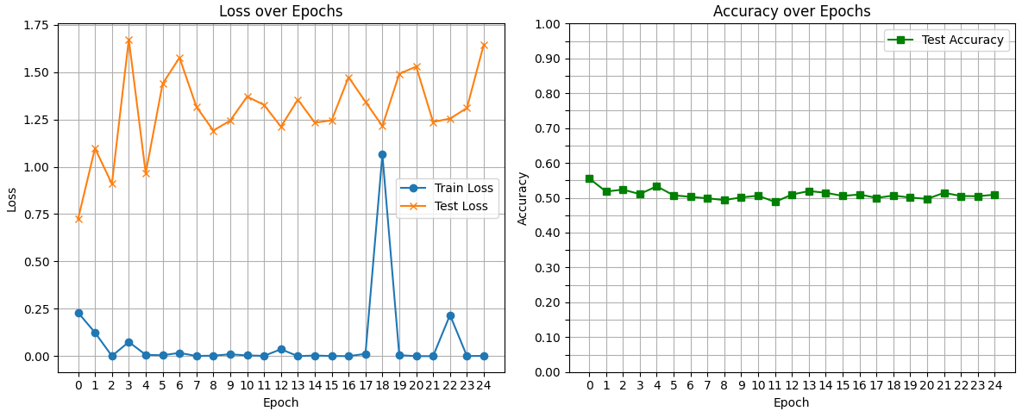
GAT MD2 SPECIFIC RESIDUES
(manual validation)
training_loss test_accuracy test_loss
0 2.298070e-01 0.555667 0.724370
1 1.244989e-01 0.518000 1.097622
2 7.985026e-04 0.523333 0.909503
3 7.499783e-02 0.510667 1.672284
4 7.089104e-03 0.533000 0.966078
5 4.741615e-03 0.507000 1.438013
6 1.727124e-02 0.502667 1.575869
7 8.729461e-04 0.498444 1.316626
8 2.737586e-03 0.493444 1.190858
9 9.894020e-03 0.501000 1.243673
10 3.926308e-03 0.506000 1.370391
11 1.557805e-03 0.488000 1.326253
12 3.649797e-02 0.509222 1.211065
13 8.344647e-07 0.519222 1.354583
14 3.363430e-03 0.514444 1.232716
15 7.696765e-04 0.505333 1.244928
16 2.181292e-04 0.509444 1.473041
17 1.213101e-02 0.499667 1.342803
18 1.064818e+00 0.506333 1.214578
19 5.091558e-03 0.500667 1.490517
20 9.345572e-05 0.496778 1.528634
21 4.088795e-05 0.514333 1.236514
22 2.172518e-01 0.505000 1.254042
23 6.591293e-04 0.504444 1.310009
24 1.494601e-03 0.509000 1.645705

Slide 30
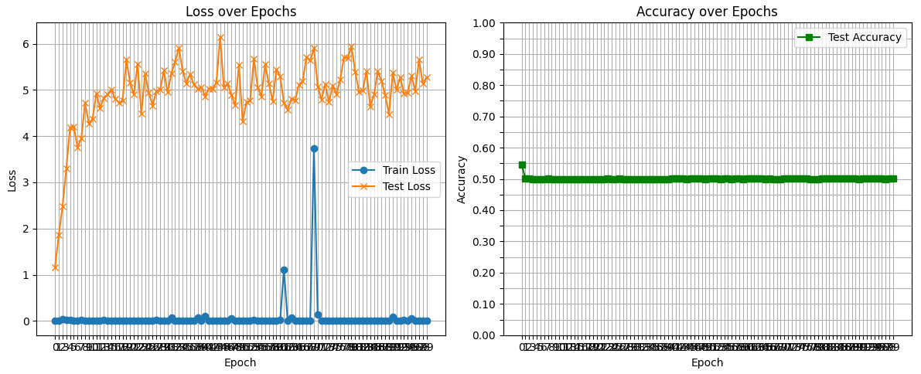
GAT MD2 SPECIFIC RESIDUES
(manual validation)

Slide 31
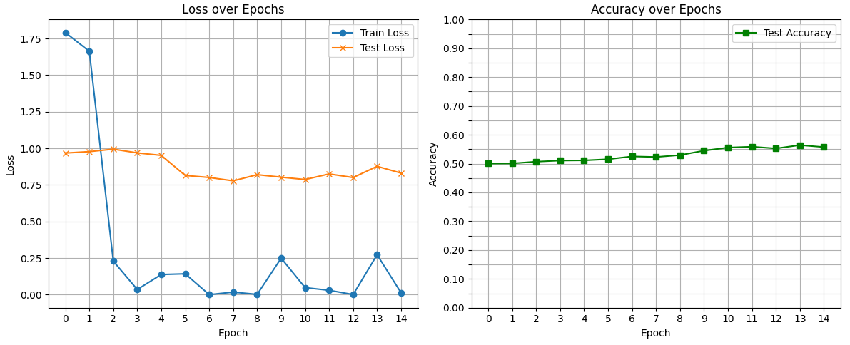
GAT MD2 SPECIFIC RESIDUES
(manual validation dropout more data)
training_loss test_accuracy test_loss
0 1.790475 0.500278 0.967295
1 1.662729 0.500556 0.977245
2 0.228971 0.506722 0.994165
3 0.035311 0.510556 0.968620
4 0.137627 0.511222 0.951587
5 0.142400 0.515167 0.814434
6 0.000274 0.524889 0.800665
7 0.017432 0.522944 0.777609
8 0.001927 0.529500 0.819858
9 0.248937 0.544944 0.802701
10 0.047916 0.555667 0.786774
11 0.029872 0.558556 0.824942
12 0.000678 0.552556 0.800234
13 0.272472 0.564167 0.876818
14 0.012610 0.557278 0.830554

